Slide 1
React Native
Part 2

Slide 2
Agenda
Let’s know each other
A word on hybrid mobile development
Setting up the development environment
Node, Xcode, Android Studio
React Native CLI
Creating And Running HelloWorld React Native
Birds view on mobile platforms ios and android
Introduction to React Native
Core Components and Native Components
React Fundamentals
Handling Text Input
Using a ScrollView
Using List Views

Slide 3
Let’s know each other
Who am I ?
Programming Experience
City you like most

Slide 4
A word on hybrid mobile development
Hybrid vs Native App: What’s the Difference
What is Hybrid App Development?
What Are Hybrid Apps?
Why Choose Hybrid Mobile App Development?
Key Benefits of Hybrid App Development
What are The Most Popular Hybrid Mobile App Development Frameworks?
Notes:
You would agree, the choice of building mobile apps depends on business needs and user expectations. While web-based and native apps have several benefits, hybrid mobile applications have garnered popularity. It is because of their adaptability across various platforms to build applications that provide consistent performance regardless of the platform. Besides being cost-effective, hybrid apps make it slightly faster to reserve a spot in the app store market.

Slide 5
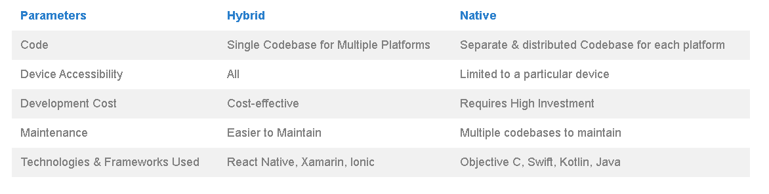
Hybrid vs Native App: What’s the Difference

Slide 6
What is Hybrid App Development?
Creating a single mobile application that is compatible with various operating systems – Android and iOS.
Write the code once, run everywhere to build an app.
Leverages different plugins to enable unrestrained access to the features of the mobile device.
Web technologies like HTML5, CSS and JavaScript are the core of these apps while deploying a native container.
Some popular apps- Twitter, Instagram, Uber, Gmail, and more.
Notes:
1. As the name suggests, this approach entails creating a single mobile application that is compatible with various operating systems – Android and iOS.
2. Hybrid development adopts an approach to write the code once, run everywhere to build an app.
3. It leverages different plugins to enable unrestrained access to the features of the mobile device.
4. Web technologies like HTML5, CSS and JavaScript are the core of these apps while deploying a native container.
5. Some popular examples of applications that amaze customers with their high performance, interface & functionality include Twitter, Instagram, Uber, Gmail, and more.

Slide 7
What Are Hybrid Apps?
It is a software application that combines elements of both native apps and web applications.
They are primarily web applications in a native app environment that connect with the mobile platform capabilities embedded in the app.

Slide 8
Why Choose Hybrid Mobile App Development?
Hybrid apps use shared code to deploy across multiple platforms – Android and iOS.
It offers a perfect blend of both native and web features.
It provides a unique avenue for enterprises looking for an app that works on various devices to expand their business operations.
It lets you engage customers irrespective of the platform they use. Whether you want an app to entice, be a game, or take photos, these types of apps offer tons of excellent options to leap into the mobility world.

Slide 9
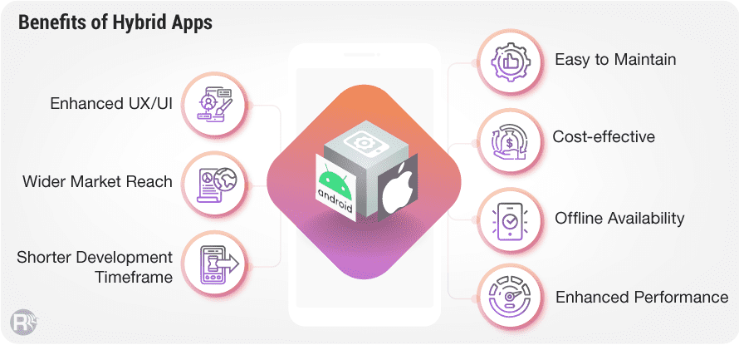
Key Benefits of Hybrid App Development
Notes:
Let’s look at the core advantages of how this mobile development approach helps businesses from around the world seamlessly leverage multiple platforms. It is the most sought-after approach thanks to the growth in the number of mobile users, app usage, device fragmentation, and more.
Enhanced UX/UI
Hybrid mobile development combines the advantages of native and web apps. It offers a consistent and flawless user experience across iOS, Android platforms. It is about making it work for mobile by embracing the web. Further, the lightweight hybrid app UI helps in loading content and graphics quickly. The apps adapt to different device screens for quick data display and seamless data streaming. The excellent UI experience even improves the chances of the application’s approval at the app store.
Wider Market Reach
They are perfect to target different platforms with one solution. In this competitive marketplace, it becomes a lucrative and cost-effective option to reach out to a high number of users using different mobile platforms.
Shorter Development Timeframe
One of the main advantages of hybrid mobile apps is that they are easier and faster to develop than a native app. It enables organizations to leverage their existing web development tool kit to eliminates the need to create a new codebase across each platform. With knowledge of JavaScript and HTML, the code gets written while the application operates across all major operating systems.
Easy to Maintain
Hybrid mobile application development offers simplified maintenance. For native apps, the development teams need to roll out new versions for every platform with each update. A hybrid app eliminates versioning and makes app management as simple as updating a web page, that too in real-time.
Cost-effective
This approach enables the targeting of multiple platforms without maintaining numerous code bases. Unlike native apps, with a single code base for various platforms, the hybrid apps enable development teams to accelerate the development process. It reduces the time to market significantly. The app can be published on multiple mobile app stores with a common code.
Offline Availability
Mobile applications commonly suffer from limitations arising due to the lack of offline support. It is a challenge for companies who cater to customers from rural areas or places where internet connectivity is a challenge.
Statistics indicate that 70 percent of users abandon an app because it takes too long to load. The offline accessibility feature helps overcome this challenge. Therefore, the end-users can have uninterrupted access to the app’s data without performance glitches.
Enhanced Performance
Hybrid apps offer high speed and performance just like native apps. In fact, in some cases, they are even faster than progressive and responsive apps. The reason being no dependency on network communication. Further, even apps with a higher number of users exhibit better speed on all devices. They have proven their performance standards with brands like Twitter and LinkedIn.

Slide 10
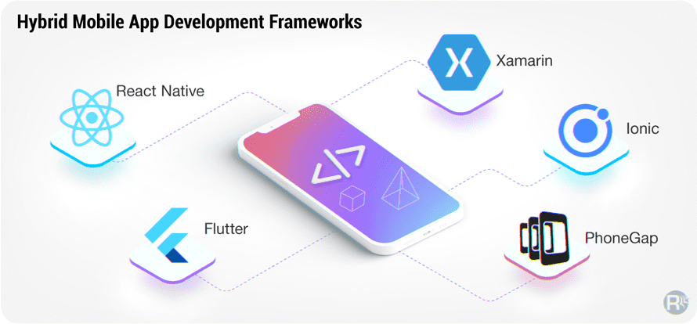
What are The Most Popular Hybrid Mobile App Development Frameworks?
Notes:
Let’s take a quick look at some of the hybrid app development frameworks and their unique features:
React Native It is one of the top choices of development teams across the globe. It is not only the most preferred option for creating hybrid apps but also popular for native & cross-platform apps. This is because it comes equipped with a world of advanced features and functionalities such as code reusability, live reload, community support, native plug-ins, and more. It is a logical option for companies looking to build high-performance apps by delivering users a native-like experience.
Flutter Powered by Google, it is an open-source framework known for its speed and reliability to build highly interactive native interfaces. It offers a rich collection of widgets for customization, SDKs, and plenty of other development tools that make it quite easier and quicker to create hybrid apps.
Xamarin Our next pick for this list is the Xamarin development framework. Owned by technology behemoth — Microsoft, it is compatible with any mobile platform. It enables developers to create universal apps without compromising the native design.
Ionic It has gained massive popularity in the recent past. It offers an extensive set of features & tools. It is powered with integrations including native mobile UI components & layouts as well as debugging & testing tools to build interactive apps.
PhoneGap This open-source app development framework is highly recommended for its compatibility and ease-of-use functionality across various platforms. It leverages the power of the Cordova plugin that makes it easier and quicker to develop apps.

Slide 11
Introduction to React Native
Developed by Meta (Facebook)
React Native is based on React JS
Single codebase is used for both Android and iOS
It is beneficial for those who already know Java Script
It uses native components instead of web components as building blocks.
To understand basic structure of React Native, we must know basic React concepts, like JSX, components, state, and props
If you already know React, you still need to learn some React Native specific stuff, like the native components.
This training is aimed at all audiences, whether you have React experience or not.
Notes:
React Native is like React, but it uses native components instead of web components as building blocks. So to understand the basic structure of a React Native app, you need to understand some of the basic React concepts, like JSX, components, state, and props. If you already know React, you still need to learn some React Native specific stuff, like the native components. This tutorial is aimed at all audiences, whether you have React experience or not.

Slide 12
Advantages
Single codebase for both the platforms
Hot Reload
Strong Performance
Active community support

Slide 13
Disadvantages
Sometimes code becomes very confusing
In the beginning you find it hard
Native development still needed

Slide 14
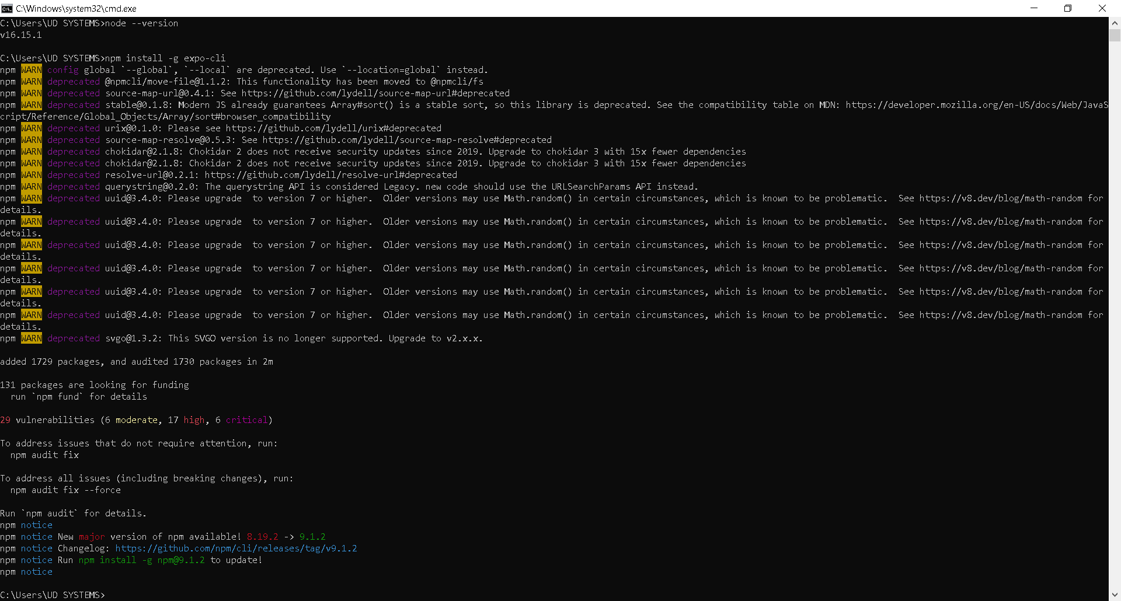
Setting up the development environment
For windows/ios:
Install Node from https://nodejs.org/en/ (Recommeded to download LTS version)
Check node --version
Install expo cli using npm install -g expo-cli
Install Android Studio/Xcode
https://developer.android.com/studio
https://developer.apple.com/
Notes:
If you are already familiar with mobile development, you may want to use React Native CLI. It requires Xcode or Android Studio to get started. If you already have one of these tools installed, you should be able to get up and running within a few minutes. If they are not installed, you should expect to spend about an hour installing and configuring them.

Slide 15
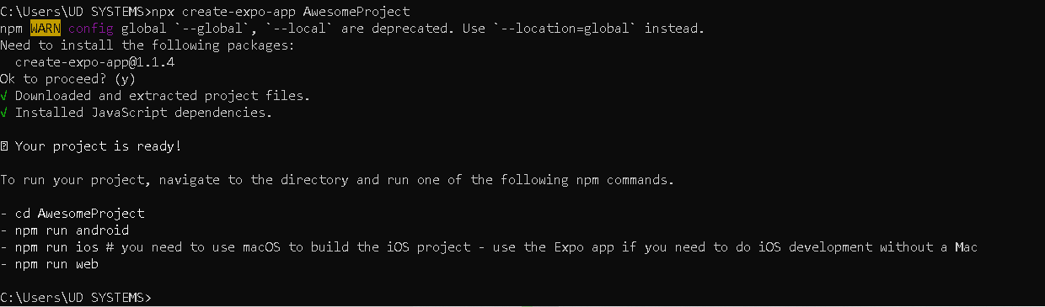
Create first react native project

Slide 16
Setup
Setup Completion – Expo and React Native CLI

Slide 17
Hello World Example
import React from 'react';
import { Text, View } from 'react-native';
const HelloWorldApp = () => {
return (
<View
style={{
flex: 1,
justifyContent: "center",
alignItems: "center"
}}>
<Text>Hello, world!</Text>
</View>
)
}
export default HelloWorldApp;
Notes:
In accordance with the ancient traditions of our people, we must first build an app that does nothing except say "Hello, world!".
What's going on here?
First of all, we need to import React to be able to use JSX, which will then be transformed to the native components of each platform.
On line 2, we import the Text and View components from react-native
Then we define the HelloWorldApp function, which is a functional component and behaves in the same way as in React for the web. This function returns a View component with some styles and aText as its child.
The Text component allows us to render a text, while the View component renders a container. This container has several styles applied, let's analyze what each one is doing.
The first style that we find is flex: 1, the flex prop will define how your items are going to "fill" over the available space along your main axis. Since we only have one container, it will take all the available space of the parent component. In this case, it is the only component, so it will take all the available screen space.
The following style is justifyContent: "center". This aligns children of a container in the center of the container's main axis. Finally, we have alignItems: "center", which aligns children of a container in the center of the container's cross axis.
Some of the things in here might not look like JavaScript to you. Don't panic. This is the future.
First of all, ES2015 (also known as ES6) is a set of improvements to JavaScript that is now part of the official standard, but not yet supported by all browsers, so often it isn't used yet in web development. React Native ships with ES2015 support, so you can use this stuff without worrying about compatibility. import, export, const and from in the example above are all ES2015 features. If you aren't familiar with ES2015, you can probably pick it up by reading through sample code like this tutorial has. If you want, this page has a good overview of ES2015 features.
The other unusual thing in this code example is <View><Text>Hello world!</Text></View>. This is JSX - a syntax for embedding XML within JavaScript. Many frameworks use a specialized templating language which lets you embed code inside markup language. In React, this is reversed. JSX lets you write your markup language inside code. It looks like HTML on the web, except instead of web things like <div> or <span>, you use React components. In this case, <Text> is a Core Component that displays some text and View is like the <div> or <span>.

Slide 18
Core Components and Native Components
React Native is an open source framework for building Android and iOS applications using React and the app platform’s native capabilities.
With React Native, you use JavaScript to access your platform’s APIs as well as to describe the appearance and behavior of your UI using React components: bundles of reusable, nestable code.
First, let’s cover how components work in React Native.

Slide 19
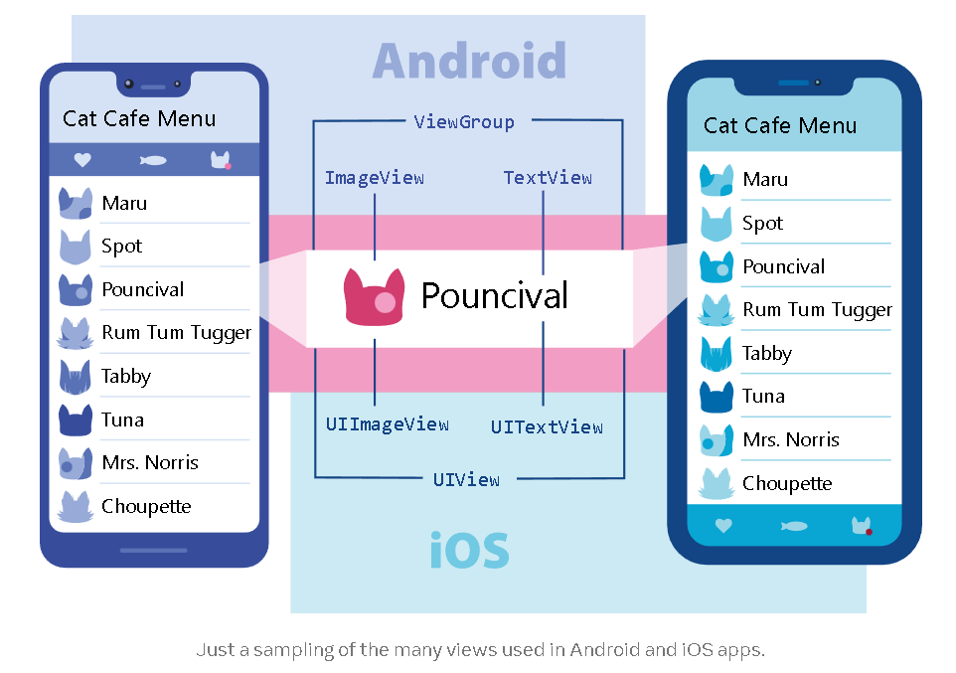
Views and mobile development
In Android and iOS development, a view is the basic building block of UI: a small rectangular element on the screen which can be used to display text, images, or respond to user input.
Even the smallest visual elements of an app, like a line of text or a button, are kinds of views. Some kinds of views can contain other views. It’s views all the way down!

Slide 20
Native Components
In Android development, we write views in Kotlin or Java;
In iOS development, we use Swift or Objective-C.
With React Native, we can invoke these views with JavaScript using React components.
At runtime, React Native creates the corresponding Android and iOS views for those components. Because React Native components are backed by the same views as Android and iOS, React Native apps look, feel, and perform like any other apps.
We call these platform-backed components Native Components.
React Native comes with a set of essential, ready-to-use Native Components we can use to start building our app today. These are React Native's Core Components.
React Native also lets us build our own Native Components for Android and iOS to suit our app’s unique needs.
We also have a thriving ecosystem of these community-contributed components. Check out Native Directory to find what the community has been creating.

Slide 21
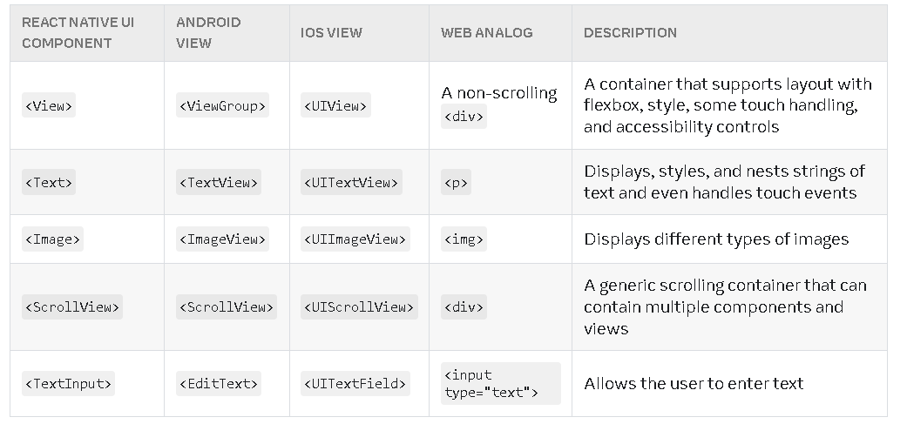
Core Components
React Native has many Core Components for everything from controls to activity indicators.
We can find them all documented in the API section.
We will mostly work with the following Core Components:
Notes:
In the next section, you will start combining these Core Components to learn about how React works. Have a play with them here now!
Because React Native uses the same API structure as React components, you’ll need to understand React component APIs to get started.

Slide 22
Core Components
DEMO
HelloWorldApp.js

Slide 23
React Fundamentals
React Native runs on React, a popular open source library for building user interfaces with JavaScript.
To make the most of React Native, it helps to understand React itself.
We’re going to cover the core concepts behind React:
components
JSX
props
state

Slide 24
Your first component
Function Component
import React from 'react';
import { Text } from 'react-native';
const HelloWorld = () => {
return (
<Text>Hello, How are you ? Good Morning everyone !</Text>
);
}
export default HelloWorld;
Class Component
import React, { Component } from 'react';
import { Text } from 'react-native';
class HelloWorld extends Component {
render() {
return (
<Text>Hello, How are you ? Good Morning everyone !</Text>
);
}
}
export default HelloWorld;
Class components tend to be a bit more verbose than function components.
Notes:
You additionally import Component from React:
Your component starts as a class extending Component instead of as a function:
Class components have a render() function. Whatever is returned inside it is rendered as a React element:
And as with function components, you can export your class component:
Now take a closer look at that return statement. <Text>Hello, I am your cat!</Text> is using a kind of JavaScript syntax that makes writing elements convenient: JSX.

Slide 25
JSX
React and React Native use JSX,
a syntax that lets you write elements inside JavaScript like so:
<Text>Hello, I am your trainer!</Text>
The React docs have a comprehensive guide to JSX you can refer to learn even more.
Because JSX is JavaScript, you can use variables inside it.
Here you are declaring a name for the trainer, name, and embedding it with curly braces inside <Text>.

Slide 26
JSX - example
import React from 'react';
import { Text } from 'react-native';
const HelloWorld = () => {
const name = “Prabhat";
return (
<Text>Hello, I am {name}!</Text>
);
}
export default HelloWorld;

Slide 27
JSX - example
Any JavaScript expression will work between curly braces, including function calls like {getFullName(“Narendra", “Damodar Das", “Modi")}:
import React from 'react';
import { Text } from 'react-native';
const getFullName = (firstName, secondName, thirdName) => {
return firstName + " " + secondName + " " + thirdName;
}
const Hello = () => {
return (
<Text>
Hello, I am {getFullName(“Narendra", “Damodar Das", “Modi")}!
</Text>
);
}
export default Hello;
Notes:
You can think of curly braces as creating a portal into JS functionality in your JSX!
Because JSX is included in the React library, it won’t work if you don’t have import React from 'react' at the top of your file!

Slide 28
Custom Components
import React from 'react';
import { Text, TextInput, View } from 'react-native';
const Cat = () => {
return (
<View>
<Text>Hello, I am...</Text>
<TextInput
style={{
height: 40,
borderColor: 'gray',
borderWidth: 1
}}
defaultValue="Name me!"
/>
</View>
);
}
export default Cat;
We’ve already met React Native’s Core Components.
React lets us nest these components inside each other to create new components.
These nestable, reusable components are at the heart of the React paradigm.
For example, we can nest Text and TextInput inside a View below, and React Native will render them together:
Notes:
On Android, you usually put your views inside LinearLayout, FrameLayout, RelativeLayout, etc. to define how the view’s children will be arranged on the screen. In React Native, View uses Flexbox for its children’s layout. You can learn more in our guide to layout with Flexbox.

Slide 29
Custom Components - example
Multiple Components:
We can render this component multiple times and in multiple places without repeating our code by using <Cat>:
import React from 'react';
import { Text, View } from 'react-native';
const Cat = () => {
return (
<View>
<Text>I am also a cat!</Text>
</View>
);
}
const Cafe = () => {
return (
<View>
<Text>Welcome!</Text>
<Cat />
<Cat />
<Cat />
</View>
);
}
export default Cafe;
Notes:
Any component that renders other components is a parent component. Here, Cafe is the parent component and each Cat is a child component.
You can put as many cats in your cafe as you like. Each <Cat> renders a unique element—which you can customize with props.

Slide 30
Props
import React from 'react';
import { Text, View } from 'react-native';
const Cat = (props) => {
return (
<View>
<Text>Hello, I am {props.name}!</Text>
</View>
);
}
const Cafe = () => {
return (
<View>
<Cat name="Maru" />
<Cat name="Jellylorum" />
<Cat name="Spot" />
</View>
);
}
export default Cafe;
Props is short for “properties”.
Props let us customize React components.
For example, here you pass each <Cat> a different name(multiple props) for Cat to render:

Slide 31
Props
import React from 'react';
import { Text, View, Image } from 'react-native';
const CatApp = () => {
return (
<View>
<Image
source={{uri: "https://reactnative.dev/docs/assets/p_cat1.png"}}
style={{width: 200, height: 200}}
/>
<Text>Hello, I am your cat!</Text>
</View>
);
}
export default CatApp;
Most of React Native’s Core Components can be customized with props, too.
For example, when using Image, you pass it a prop named source to define what image it shows:
Notes:
Image has many different props, including style, which accepts a JS object of design and layout related property-value pairs.

Slide 32
Note
Notice the double curly braces {{ }} surrounding style‘s width and height. In JSX, JavaScript values are referenced with {}.
This is handy if you are passing something other than a string as props, like an array or number: <Cat food={["fish", "kibble"]} age={2} />.
However, JS objects are also denoted with curly braces: {width: 200, height: 200}. Therefore, to pass a JS object in JSX, you must wrap the object in another pair of curly braces: {{width: 200, height: 200}}
We can build many things with props and the Core Components Text, Image, and View!
But to build something interactive, we’ll need state.

Slide 33
State
State is like a component’s personal data storage.
State is useful for handling data that changes over time or that comes from user interaction.
State gives your components memory!
As a general rule, use props to configure a component when it renders. Use state to keep track of any component data that you expect to change over time.
Notes:
While we can think of props as arguments you use to configure how components render, state is like a component’s personal data storage. State is useful for handling data that changes over time or that comes from user interaction. State gives your components memory!

Slide 34
State
Example
The following example takes place in a cat cafe where two hungry cats are waiting to be fed.
Their hunger, which we expect to change over time (unlike their names), is stored as state.
To feed the cats, press their buttons—which will update their state.

Slide 35
State
import React, { useState } from "react";
import { Button, Text, View } from "react-native";
const Cat = (props) => {
const [isHungry, setIsHungry] = useState(true);
return (
<View>
<Text>
I am {props.name}, and I am {isHungry ? "hungry" : "full"}!
</Text>
<Button
onPress={() => {
setIsHungry(false);
}}
disabled={!isHungry}
title={isHungry ? "Pour me some milk, please!" : "Thank you!"}
/>
</View>
);
}
const Cafe = () => {
return (
<>
<Cat name="Munkustrap" />
<Cat name="Spot" />
</>
);
}
export default Cafe;
Example using Functional Component
We can add state to a component by calling React’s useState Hook.
A Hook is a kind of function that lets you “hook into” React features.
For example, useState is a Hook that lets you add state to function components.
For reference :
State.js
Example using Class Component
For reference :
StateClassComponent.js

Slide 36
Handling Text Input
TextInput is a Core Component that allows the user to enter text.
It has an onChangeText prop that takes a function to be called every time the text changed, and an onSubmitEditing prop that takes a function to be called when the text is submitted.
For example, let's say that as the user types, you're translating their words into a different language.
In this new language, every single word is written the same way: 🍕.
So the sentence "Hello there Bob" would be translated as "🍕 🍕 🍕".

Slide 37
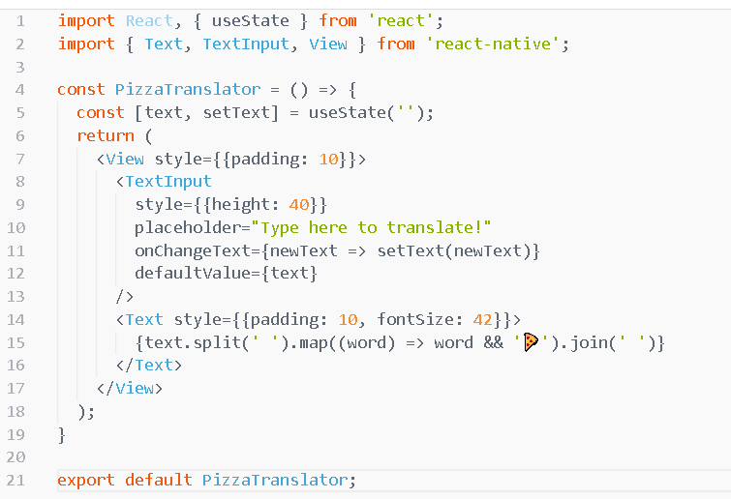
Handling Text Input - Example
DEMO - PizzaTranslator.js
Notes:
In this example, we store text in the state, because it changes over time.
There are a lot more things you might want to do with a text input. For example, you could validate the text inside while the user types. For more detailed examples, see the React docs on controlled components, or the reference docs for TextInput.
Text input is one of the ways the user interacts with the app. Next, let's look at another type of input and learn how to handle touches.

Slide 38
Using a ScrollView
The ScrollView is a generic scrolling container that can contain multiple components and views.
The scrollable items can be heterogeneous, and you can scroll both vertically and horizontally (by setting the horizontal property).
This example creates a vertical ScrollView with both images and text mixed together.

Slide 39
Using a ScrollView - Example
Demo
ScrollViewApp.js

Slide 40
Using a ScrollView
ScrollViews can be configured to allow paging through views using swiping gestures by using the pagingEnabled props. Swiping horizontally between views can also be implemented on Android using the ViewPager component.
On iOS a ScrollView with a single item can be used to allow the user to zoom content. Set up the maximumZoomScale and minimumZoomScale props and your user will be able to use pinch and expand gestures to zoom in and out.
The ScrollView works best to present a small number of things of a limited size. All the elements and views of a ScrollView are rendered, even if they are not currently shown on the screen. If you have a long list of items which cannot fit on the screen, you should use a FlatList instead. So let's learn about list views next.
Notes:
ScrollViews can be configured to allow paging through views using swiping gestures by using the pagingEnabled props. Swiping horizontally between views can also be implemented on Android using the ViewPager component.
On iOS a ScrollView with a single item can be used to allow the user to zoom content. Set up the maximumZoomScale and minimumZoomScale props and your user will be able to use pinch and expand gestures to zoom in and out.
The ScrollView works best to present a small number of things of a limited size. All the elements and views of a ScrollView are rendered, even if they are not currently shown on the screen. If you have a long list of items which cannot fit on the screen, you should use a FlatList instead. So let's learn about list views next.

Slide 41
Using List Views
React Native provides a suite of components for presenting lists of data. Generally, you'll want to use either FlatList or SectionList.
One of the most common uses for a list view is displaying data that you fetch from a server.
The FlatList component displays a scrolling list of changing, but similarly structured, data.
FlatList works well for long lists of data, where the number of items might change over time.
Unlike the more generic ScrollView, the FlatList only renders elements that are currently showing on the screen, not all the elements at once.
The FlatList component requires two props:
data is the source of information for the list.
renderItem takes one item from the source and returns a formatted component to render.

Slide 42
Using List Views – Flat List example
This example creates a basic FlatList of hardcoded data.
Each item in the data props is rendered as a Text component.
The FlatListBasics component then renders the FlatList and all Text components.
DEMO - FlatListBasics.js

Slide 43
Using List Views – Section List example
If you want to render a set of data broken into logical sections, maybe with section headers, similar to UITableViews on iOS, then a SectionList is the way to go.
DEMO - SectionListBasics.js
Notes:
To do that, you will need to learn about networking in React Native.

Slide 44
References
https://www.rishabhsoft.com/blog/hybrid-mobile-app-development
https://reactnative.dev/docs/getting-started

